Slide 1

AUTOMATIC WATERING SYSTEM FOR PLANTS
GROUP 6

Slide 2

PCB DESIGNING

Slide 3
PROJECT OVERVIEW
Our project is automatic watering system for plants.
We have done the interfacing of soil moisture sensor, light sensor, temperature and humidity sensor, motor driver and Esp 8266 till now.
After successfully interfacing all these components, we are now going to do the pcb designing.

Slide 4
TASK OBJECTIVE To generate the PCB design for our project automatic watering system for plants

Slide 5
PCB DESIGNING
PCB designing is a computer aided design technology
A printed circuit board, or PCB, is used to mechanically support and electrically connect electronic components using conductive pathways, tracks or signal traces etched from copper sheets laminated onto a non-conductive substrate.

Slide 6

IMPORTANCE OF PCB DESIGNING
The Printed Circuit Board (PCB) is very important in all electronic gadgets, which are used either for domestic use, or for industrial purpose.
PCB design services are used to design the electronic circuits. Apart from electrically connecting, it also gives mechanical support to the electrical components.
The PCB designs can be created both manually and automatically.
Manual layouts are created with the help of CAD drafting, and the automatic router helps in the creation of the designs automatically.

Slide 7
IMPORTANCE OF PCB DESIGNING
Compact Design
Ease of Testing and Repair
Lower Assembly Errors
Avoiding Short Circuits
Low Noise and Interference
Improved Repeatability and Reliability

Slide 8
EasyEDA
EasyEDA is a web-based EDA tool suite that enables hardware engineers to design, simulate, share - publicly and privately - and discuss schematics, simulations and printed circuit boards. Other features include the creation of a bill of materials, Gerber files and pick and place files and documentary outputs in PDF, PNG and SVG formats.
EasyEDA is a free, easy-to-use and without any installation brings the fast PCB design and easier circuit design experience.
EasyEDA allows the creation and editing of schematic diagrams, simulation of mixed analogue and digital circuits and the creation and editing of printed circuit board layouts and, optionally, the manufacture of printed circuit boards.

Slide 9
EasyEDA
Subscription-free membership is offered for public plus a limited number of private projects.
The number of private projects can be increased by contributing high quality public projects, schematic symbols, and PCB footprints and/or by paying a monthly subscription.
EasyEDA’s PCB Design canvas helps you to quickly and easily lay out even complex multilayer designs from schematics you have already created in the Schematic canvas or directly as a layout with no schematic.

Slide 10
FEATURES OF EasyEDA
Simple, Easier, Friendly, and Powerful general drawing capabilities
Schematic Capture
PCB Layout
Working Anywhere, Anytime, Any Device
Real-time Team Cooperation
Sharing Online
Thousands of Open Source Projects
Direct Links to LCSC Components for Selection
Integrated PCB Fabrication
More Than 1 Million Free Libraries
Script Support

Slide 11
About EasyEDA Software Tools
Here, we are using the offline version of easyeda.
First, we need to create a file for the schematic.
After creating a schematic, we need to convert the schematic into PCB.

Slide 12
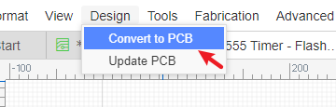
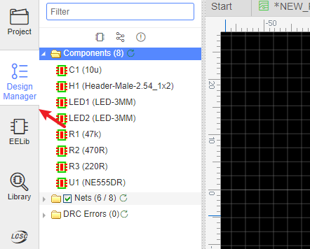
About EasyEDA Software Tools
Passing an EasyEDA Schematic into the PCB Design editor is as easy as clicking a button: Just click the Convert to PCB via: “Menu - Design - Convert to PCB”.
The PCB Design Manager is a very powerful tool for finding components, tracks (nets) and pads (Net Pads). Clicking on any item highlights the component and pans it to the center of the window.

Slide 13
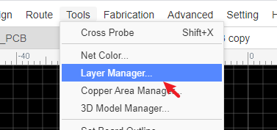
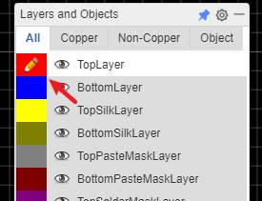
About EasyEDA Software Tools
You can set up layers used in the PCB and their display colours and visibility using Top Menu - Tools - Layer Manager…
The active layer and layer visibility can be selected using the Layers Toolbar.

Slide 14
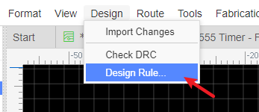
About EasyEDA Software Tools
From first setting up the Design Rule Check (DRC) at the start of your board layout, running a DRC is almost the last step in checking your PCB design before you generate Gerber and Drill files for board manufacture ready to place your order for a finished PCB
The last step is to check the Gerber and Drill files using an easy way it is to install and use Free and Open Source Software Gerber Viewer.

Slide 15
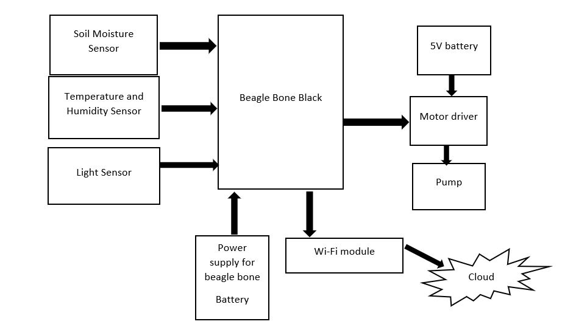
BLOCK DIAGRAM OF OUR PROJECT

Slide 16
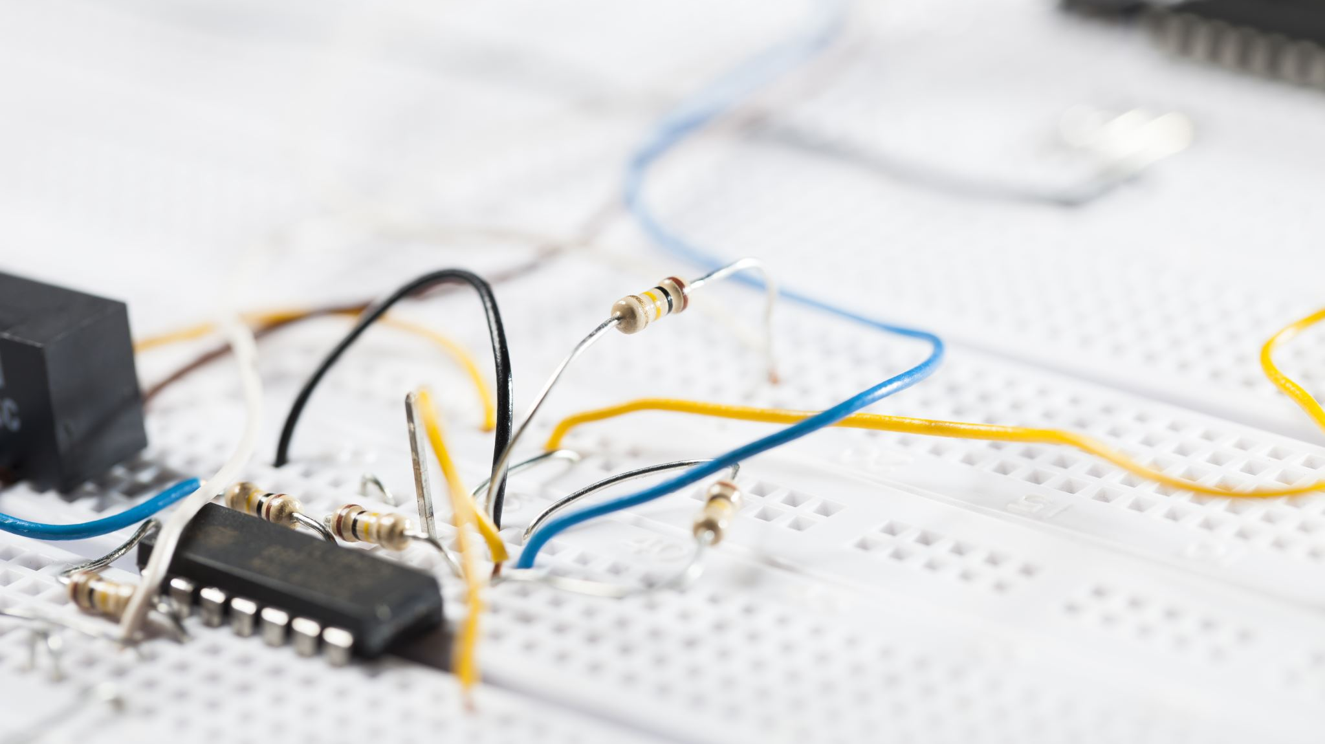
CIRCUIT CONNECTIONS FOR THE SCHEMATIC DIAGRAM

Slide 17
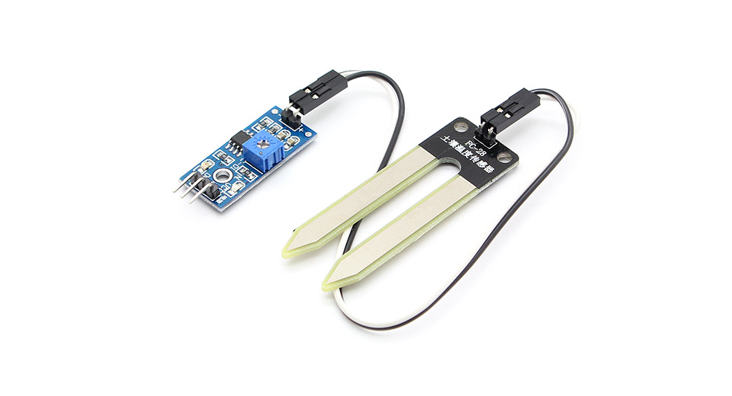
SOIL MOISTURE SENSOR | BEAGLEBONE BLACK
VCC | P9_3
GROUND | P8_1
D0 | P8_16(GPIO_46)

Slide 18
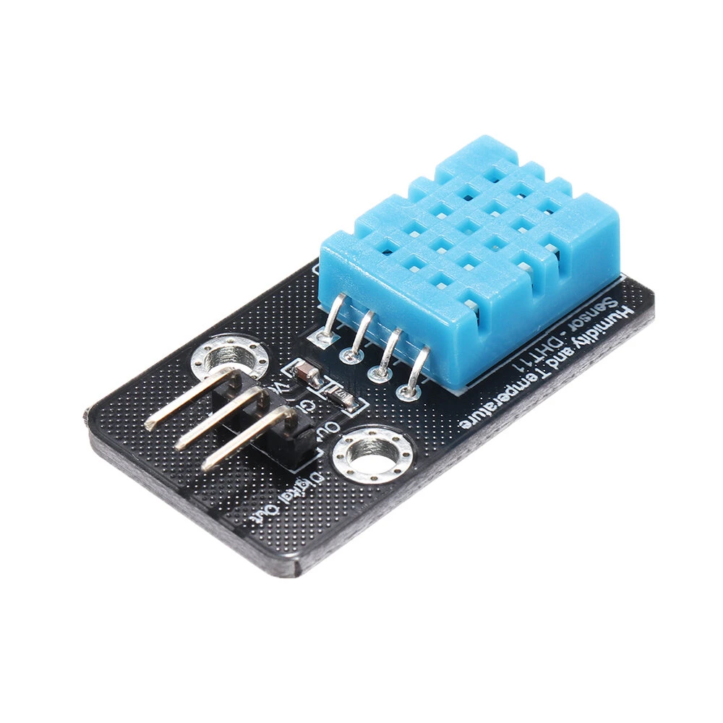
DHT11 SENSOR | BEAGLEBONE BLACK
VCC | P9_4
GROUND | P9_1
D0 | P8_15(GPIO_47)

Slide 19
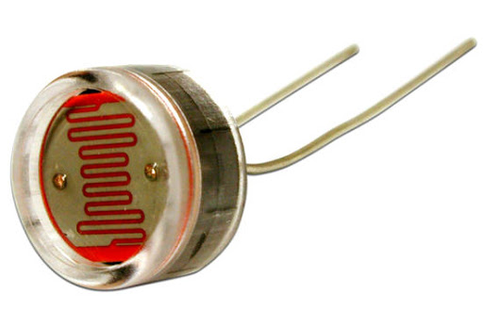
LDR SENSOR | BEAGLEBONE BLACK
ONE LEG OF THE LDR | P9_34
INTERSECTION OF LDR AND RESISTOR | P9_40
ONE LEG OF RESISTOR | P9_32

Slide 20
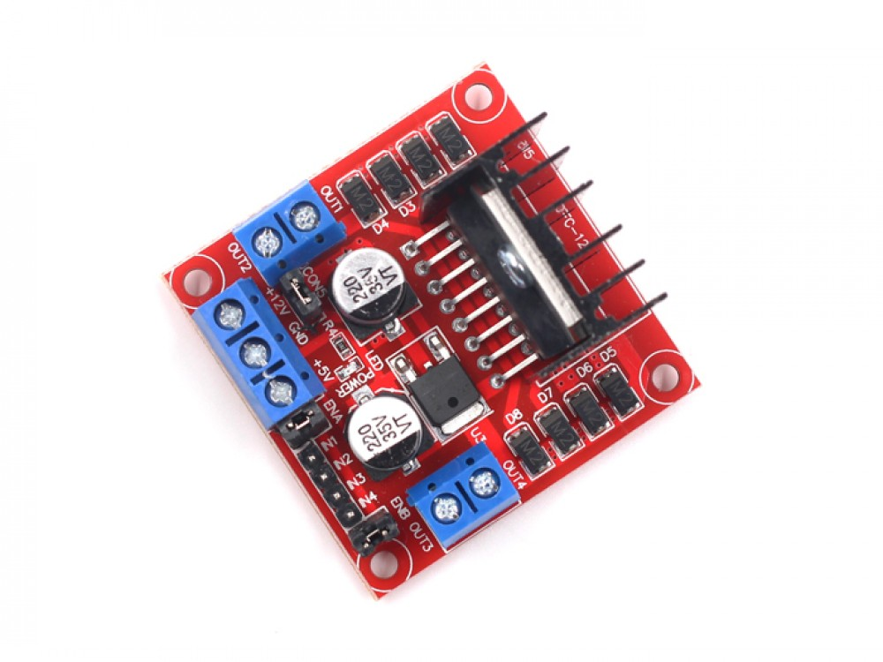
L298N MOTOR DRIVER | BEAGLEBONE BLACK
EN A | P8_25(GPIO_32)
IN1 | P8_12(GPIO_44)
IN2 | P8_11(GPIO_45)

Slide 21
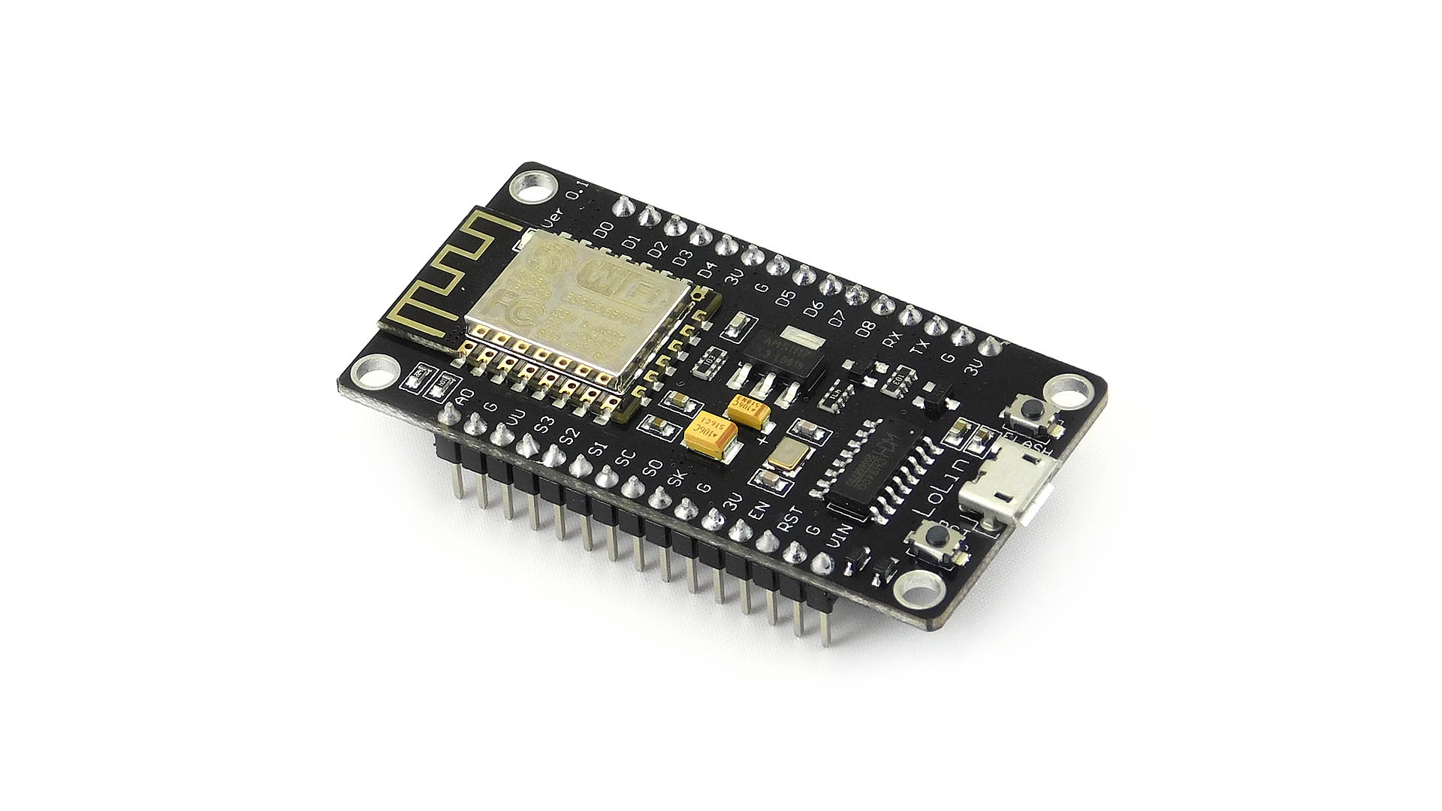
ESP8266 MODULE | BEAGLEBONE BLACK
RX | P9_24(UART1_TXD)
GROUND | P9_2

Slide 22
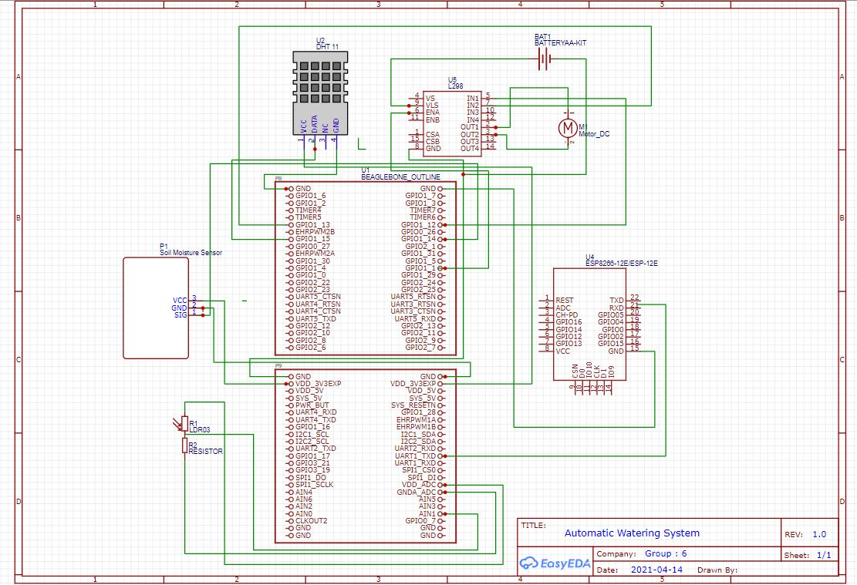
SCHEMATIC DESIGN OF OUR PROJECT

Slide 23

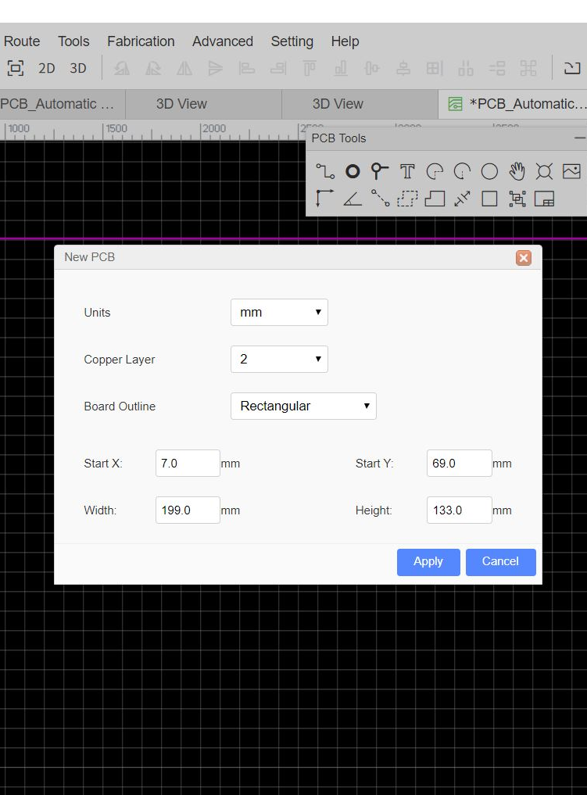
PCB DESIGNING
Once the schematic is ready, we can covert the schematic into PCB design by making use of the convert to PCB option available in the design tool of EasyEDA.

Slide 24
PCB DESIGNING
After the above, process we need to do the routing.
EasyEDA provides us the auto router, for which we need to download the local auto router server.
EasyEDA suggest that using local auto router rather than using the cloud server, because when many users using cloud server, the cloud auto router will fail.
Unzip it to the User folder.
Configure the browser.
After successfully doing the routing, we can generate the files required for the manufacturing of PCB.

Slide 25
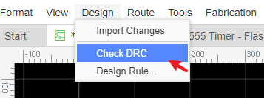
PCB DESIGNING
Any errors in routing can be checked by using the DRC.( Design Rule Check)
EasyEDA provides a real time DRC(Design Rule Check) function. This is a big feature of EasyEDA.

Slide 26
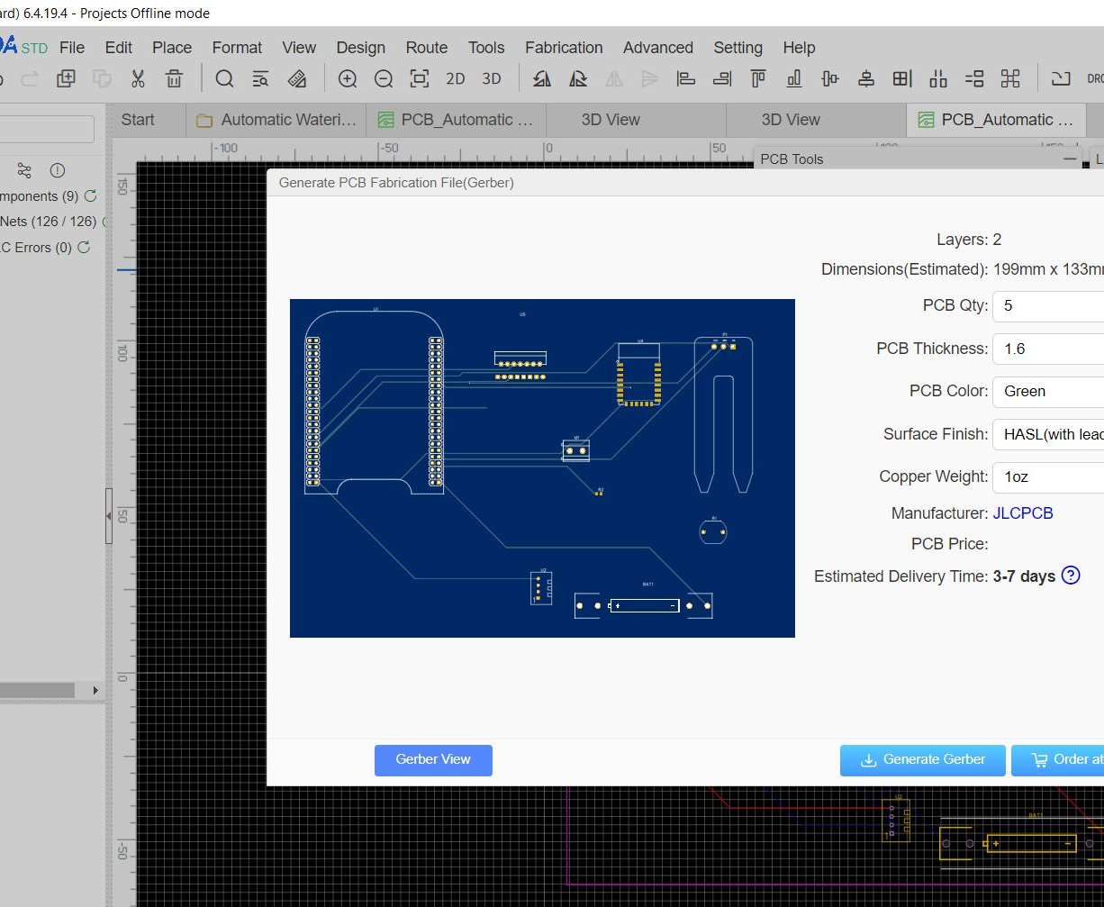
PCB DESIGNING
The gerber files can be viewed once the board is having no errors.
These are the essential files needed for the fabrication of your PCB.
By using the gerber viewer ,we can view the gerber files.

Slide 27
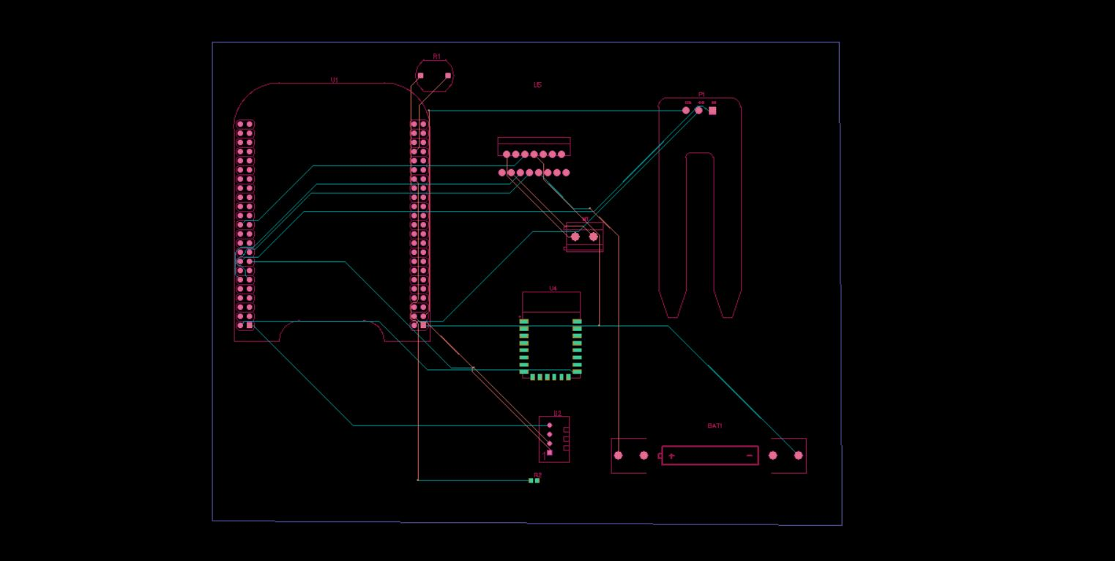
GERBER FILE : LAYERS

Slide 28
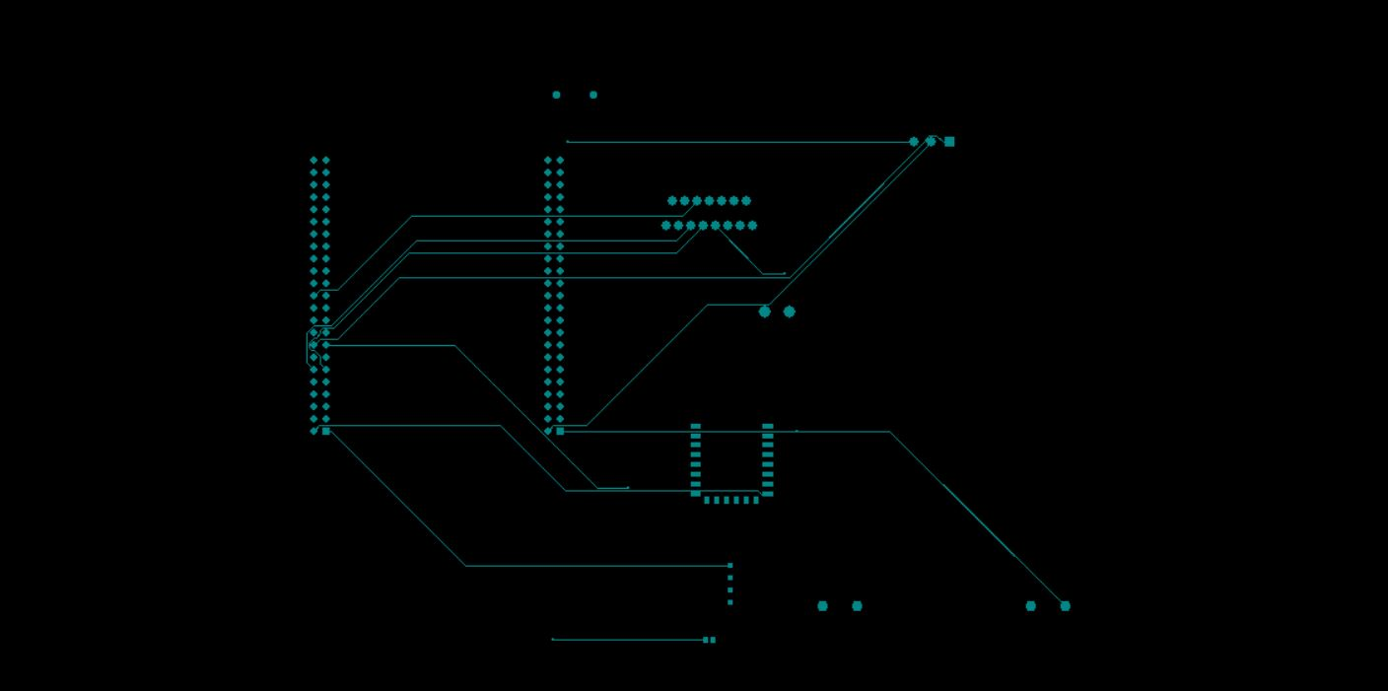
GERBER FILE : TOP LAYER

Slide 29
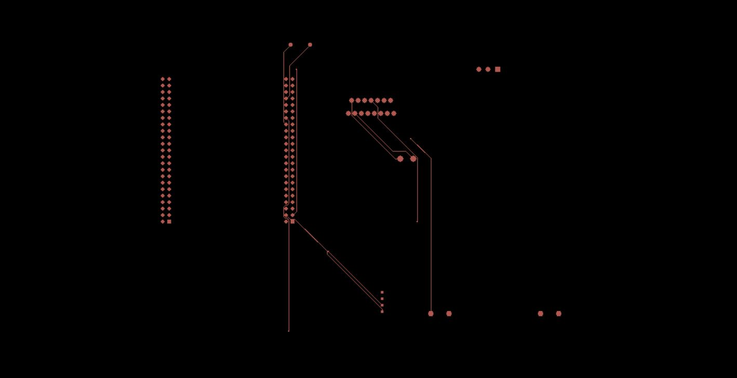
GERBER FILE : BOTTOM LAYER

Slide 30
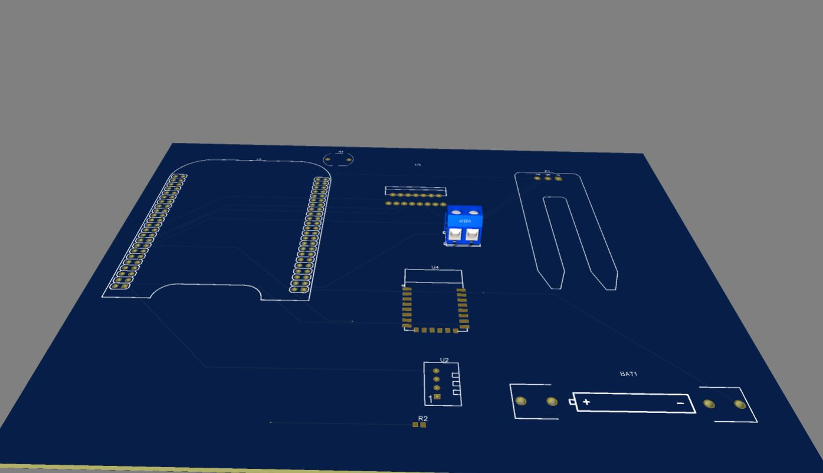
3D VIEW

Slide 31
REFERENCES
PCB Design : https://www.eurocircuits.com/pcb-printed-circuit-board/
PCB Layout : http://www.pcbdesign.org/pcb-layout/pcb-design-workflow/
PCB Importance : https://rushpcb.com/importance-of-pcbs-and-pcb-design/
PCB EasyEDA : https://easyeda.com/feather/PCB_Layout_Tutorial-LztL3XfwO
Gerber Viewer : https://sourceforge.net/projects/gerbv/files/

Slide 32

THANKYOU

